Slide 1
Gauging Student Perspectives:
Using Survey Data to Understand
Student Perceptions of Archives
Giao Luong Baker, Duke University Libraries
Suzi Noruschat, University of Southern California Libraries
Funded by USC Libraries Research Committee
Fall 2018 - Spring 2019

Slide 2
Question
Do student perceptions of USC Special Collections and Digital Library resources change after exposure to these resources via instruction or a class assignment?
Modern classroom, s.d., USC Digital Library
Notes:
Confidence level
Frequency of use
Whether they see themselves (or their communities) in these resources

Slide 3
Methodology
Survey administered to students in Fall 2018 classes
Pre and post surveys
Pre-survey was taken in person, on paper, before instruction
Survey incentive given at time of pre-survey
$10 gift cards to Starbucks
Post-survey was conducted via Qualtrics
Notes:
Pre and post surveys
Survey incentive (included a receipt that students signed and we held on to for reporting purposes)
IRB approval - exempt status
Qualtrics

Slide 4
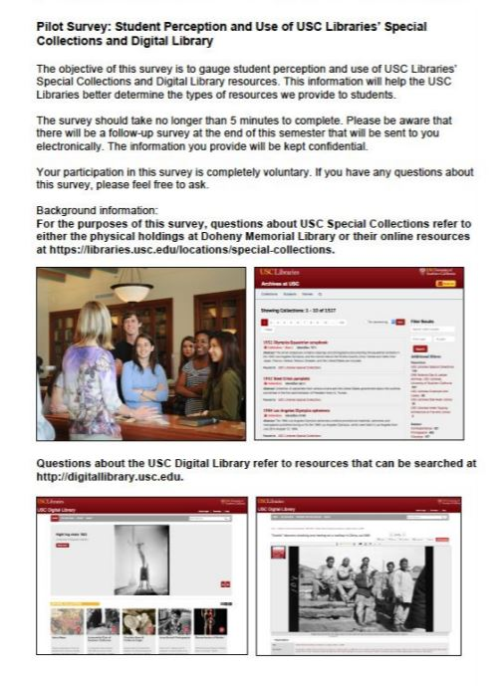
Survey
Demographic data
Familiarity with resources
Confidence level
Do they see themselves in these resources?
Notes:
General and Demographic information (7 questions); 14 questions total
Identify as first-generation college student
Are students familiar with Special Collections and Digital Library resources?
How often and under what circumstances do they use them?
How confident do they feel using them?
Do they see their own communities reflected in these resources?
Samples??? Types/content of questions; note that we used Likert scale. Address why we singled out first gen students?
Provide a sample question to show how we asked. Perhaps use a lickert scale question. This allows us to bring up the point of the importance crafting questions that yield results that can quantifiable. How you frame the question makes a big difference/impact on the type of usable data downstream.

Slide 5
Sample Questions
Multiple choice with “other”
Closed question
Notes:
Demographic information
Identify as first-generation college student
Are students familiar with Special Collections and Digital Library resources?
How often and under what circumstances do they use them?
How confident do they feel using them?
Do they see their own communities reflected in these resources?
Samples??? Types/content of questions; note that we used Likert scale. Address why we singled out first gen students?
Provide a sample question to show how we asked. Perhaps use a lickert scale question. This allows us to bring up the point of the importance crafting questions that yield results that can quantifiable. How you frame the question makes a big difference/impact on the type of usable data downstream.

Slide 6
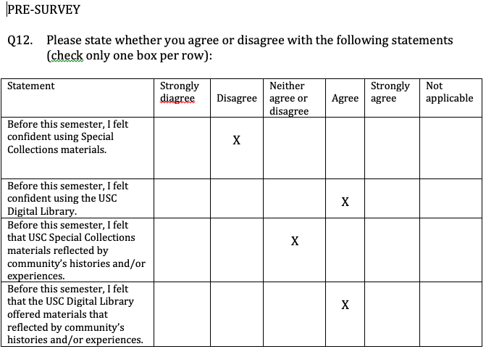
Sample Questions
Likert
Scale
Notes:
3 likert scale questions that consist of 10 questions
I found this from a website: (https://blog.leadquizzes.com/8-types-of-survey-questions/)
“Remember that last time when you were taking a survey and ‘neither agreed nor disagreed’ or ‘completely agreed/disagreed’ with a question? You may not have known it at the time, but those questions were based on what’s called a Likert scale.
It’s one of the most popular and reliable ways of measuring perceptions, attitudes, and opinions. Likert scale survey questions are characterized by a wide range of answer options to choose from, usually ranging from one extreme (e.g. ‘strongly agree’) to another (e.g. ‘strongly disagree’).
Likert scale questions are especially suitable if you want to question your audience on a new product release, customer service experience, a recent development at the company, the success of an event, and so on.
Even though Likert scale questionnaires, in theory, can have an unlimited number of questions and answers, the two most common ones are the 5-point and 7-point Likert scales. You can also decide to use even-numbered answer options, but keep in mind that such a scale eliminates the possibility of a neutral answer.

Slide 7
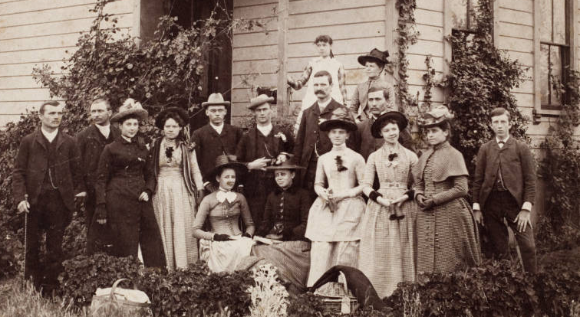
Response Overview
56.2% response rate for the post-survey
77% were undergrads
20% Identify as first-generation college student
60% of respondents were white/ 40% non-white
Freshman Picnic, May 24, 1889, USC Digital Library
Notes:
The following are some highlights of the study :Four classes -- totalling 100 students responses gathered; from that initial pool we attained 56.2% completion rate for the post-surveys. This is with the dissemination of the incentive gift cards during the 1st furvey, providing the students some time to get thru the majority of the semester, and then sending out an email with a qualtrics link. We then sent two other reminder emails with the hope of shoring up our response rate.. The majority of respondents were undergrads, who hailed from the School of Planning, Policy, and Development. This is because we had a couple of larger classes who came from that department. Consistent with USC’s statistic for first-generation students, 20% of our respondents self identified as first-generation. We asked this question because this project is based on a chapter Rachel Mandell and I wrote that focused on creating digital library resources to support the first-generation student expereince. The demographic breakdown according to race is 60% of our respondents are white, and the remaining 40% are non-white. This info helps to contextualize the data

Slide 8
Finding 1
Special Collections
Digital
Library
Notes:
Students feel more confident using Digital Library collections than they did using Special Collections materials before our instruction and/or their class assignments. We found that 45% of students responded “agree or strongly agree” with the statement “Before this semester, I felt confident using the USC Digital Library.” Only 13% of students “agreed or strongly agreed” to the same statement regarding Special Collections
More students fell confident using digital resources. Perhaps this is because you can do it in the comfort of your home, in your underwear, burrito in hand, while streaming netflix. Special collections on the other hand, requires an appointment, physically going to the location, and most importantly, being clothed.

Slide 9
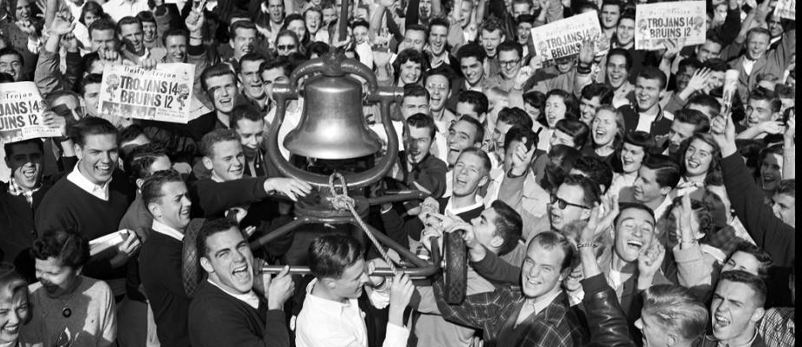
Finding 2
Students felt more confident using Special Collections materials after our instruction
The pre-survey mean is 2.56
The post-survey mean is 3.73
Return of the Victory Bell, 1952, USC Digital Library
Notes:
The encouraging news for Special Collections is that there was a statistically significant percentage change of students who felt more confident using Special Collections materials after our instruction. We were lucky enough to have receive assistance from Kathy Kolnick, a statistician at USC, to analyze our data using a Paired Sample T-Test.
Details include: Sig. (2-tailed) = .000
t(44) = 6.329, p < .001

Slide 10
Finding 3
No change in confidence levels for Digital Library resources
The pre-survey mean is 3.63
The post-survey mean is 3.93
Coach Boyd with Trojan Basketball team, 1978, USC Digital Library
Notes:
Using the same methodology, we found that there was not a statistically significant percentage of students who felt more confident using DL collections after our instruction. Perhaps this is because the initial DL mean was much higher compared to Special Collections’ pre-survey mean, and so the post-mean for this particular category had to be much higher for a change of statistical significance. Another way to analyze this finding is that perhaps instruction for DL resources has to be reconsidered in order to attain a greater impact on student’s impressions.
Details include: Sig. (2-tailed) = .128
t(45) = 1.551, p = .128

Slide 11
Finding 4
Students saw themselves and their communities reflected in both Special Collections and Digital Library resources after instruction.
Special Collections Data:
The pre-survey mean is 3.24
The post-survey mean is 3.74
Digital Library Data:
The pre-survey mean is 3.56
The post-survey mean is 3.84
USC Delta Delta Delta Sorority women, s.d., USC Digital Library
Notes:
There was a statistically significant percentage of students who saw themselves and their communities reflected in Special Collections and DL resources after instruction. Interestingly, the Digital Library means for this category are higher across the board than Special Collections. We were intrigued by this finding because we had assumed that this is an area where we could improve on. This is where the demographic data is interesting because 60% of the respondents self-identified as white and 40% was everyone else. With that, I’m going to pass the microphone back to Suzi.

Slide 12
Next Steps
Parse out demographic data further
Expand the study to more classes; wider and more representative set of research data
Include more institutions?
Notes:
Back to Suzi:
May want to look at who responded how. Is this a reflection of the demographics of the students we surveyed? The classes were predominantly white (60%?). It is possible to do a T-Test for just white students and non-white students to see if there's a difference in perspectives of this question.
Address more closely experiences of first-generation students, experiences of students contributing content to the Digital Library, and other populations;

Slide 13
Thank You!
Giao Luong Baker
Suzi Noruschat
giao.baker@duke.edu
noruscha@usc.edu
Presented at 2019 SAA Research Forum
August 2, 2019
Notes:
Back to Suzi:
Address more closely experiences of first-generation students, experiences of students contributing content to the Digital Library, and other populations

